Slide 1

Maps for Publications as per USGS Standards
By: Mel Moreno
October 15, 2020
FAS 6932

Slide 2
WHY usgs maps are important
USGS programs produce accurate geologic maps and 3-D geologic frameworks that provide critical data for sustaining and improving the quality of life and economic vitality of the Nation.
USGS maps also organize, maintain, and publish the geospatial baseline of the Nation's topography, natural landscape, built environment and more.

Slide 3
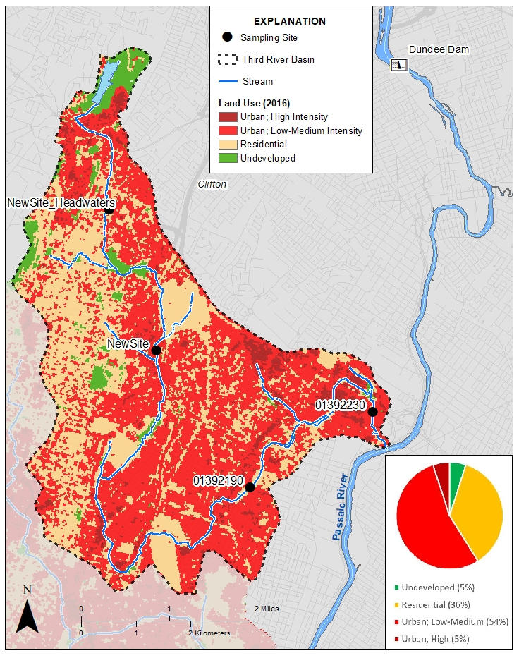
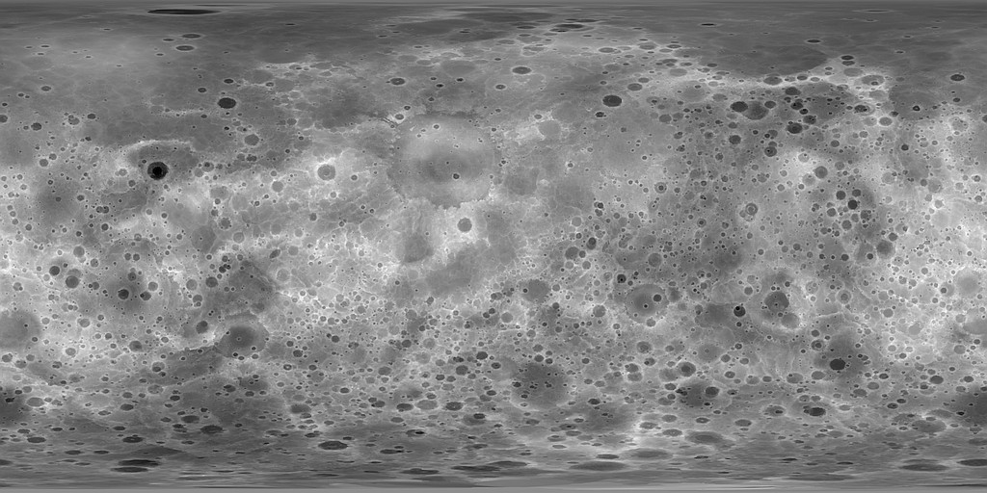
MAP EXAMPLES
Geologic Maps
Topographic Maps
Notes:
Figure (left) –
Third River - Lower Passaic River Basin 2020
Release Date: APRIL 27, 2020
Lower Passic River - Third River Basin 2020
https://www.usgs.gov/maps/third-river-lower-passaic-river-basin-2020
Figure (right)- From the USGS press release: The first topographic map of Mercury was released by the U.S. Geological Survey, Arizona State University, Carnegie Institute of Washington, Johns Hopkins University Applied Physics Laboratory and NASA. This high-resolution map provides the first comprehensive view of Mercury’s entire surface, illustrating the planet’s craters, volcanoes and tectonic landforms. This product brings together observations and scientific findings from NASA’s MErcury Surface, Space ENvironment, GEochemistry, and Ranging (MESSENGER) spacecraft, which was the first spacecraft to orbit Mercury.

Slide 4
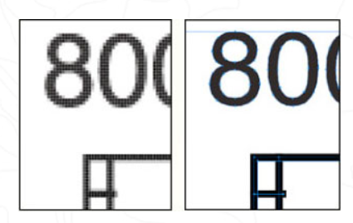
General Graphics Requirements
Caption or additional information given about the figure in the text
Some publications require a supplemental PDF file
Recommended graphic file types are .tif, .jpg, or .pdf file types
Recommended fonts, Arial, Helvetica, Times, Symbol
Figures may be supplied using RGB or CMYK colour-space.
Notes:
Figure- (left) A raster-based file is made from a grid of pixels. (right) A vector-based file is created from mathematically mapped lines and shapes. (https://www.agu.org/Publish-with-AGU/Publish/Author-Resources/Graphic-Requirements
)
-.eps is a vector graphics format. Vector graphics combine mathematically mapped points, lines, curves, and shapes to create images. These files provide the sharpest reproduction of line art, graphs, and text and can be enlarged without any loss in quality.
-.tif and .jpg files are raster graphics formats. Raster-based art forms images through a grid of pixels, or points of color. These files are best for reproducing photography and photorealistic images. The quality of a raster image depends on resolution, or the number pixels per inch (PPI). Therefore, all raster graphics must have a resolution between 300 and 600 ppi (at final size).
-.pdf is an open standard for exchanging documents. Depending on the software used to create it, a .pdf can contain high-quality vector and/or raster-based images. Always choose “Press Quality” under .pdf options.
RGB refers to the primary colors of light, Red, Green and Blue, that are used in monitors, television screens, digital cameras and scanners. CMYK refers to the primary colors of pigment: Cyan, Magenta, Yellow, and Black
ArcMap raster layers always render internally as RGB colors. This means that even when a raster is defined with the color selector in CMYK mode, it does not internally get marked as CMYK color, and the raster layers stores only the RGB equivalent.

Slide 5

What all Maps should have
TITLE
SCALE INDICATOR
ORIENTATION
BORDER(s)
LEGEND
MAP CREDITS:
- SOURCE OF DATA (especially on thematic maps)
- NAME of the cartographer
- DATE of the map creation/publication
- DATE of the map data
- PROJECTION of the map (especially small-scale maps)
LOCATOR MAP (INSET, OPTIONAL)
EFFECTIVE GRAPHICAL DESIGN
VISUAL HIERARCHY
PURPOSE
Notes:
TITLE: the title should be in a large font, easily identifiable as the title of the map and should include descriptive text as to the location and purpose of the map
2. SCALE INDICATOR: the scale of the map is typically indicated by a graphic bar scale, a representative fraction or a verbal scale
3. ORIENTATION: a map should indicate which way is north (and/or south, east and west).
4. BORDER(s) (or Neatline): a map border identifies exactly where the mapped area stops and should be close to the edges of the mapped area. The distance between the map and it’s border should be the same on all sides (balanced
5. LEGEND: required if the map uses symbols or colors (including shades of gray and patterns). Maps (and certain map features) do not need legends if the symbology is so common or simple as to be easily understood by the reader. However, it must be clear what each marker or line type, weight and pattern represents.
6. MAP CREDITS: - SOURCE OF DATA (especially on thematic maps) - NAME of the cartographer - DATE of the map creation/publication - DATE of the map data - Optional: PROJECTION of the map (especially for small-scale maps)
7. LOCATOR MAP (INSET, OPTIONAL)
8. EFFECTIVE GRAPHICAL DESIGN: the layout design is as important as effective sentence structure is to written text. Design refers to the planning and decision making processes involved in the visual display of the spatial data. You can achieve balance by rearranging the map elements (scale, north arrow, legend, title, etc.) and changing size of the text, border. etc. The map and map elements should be: - Neat and clear - Appropriately and consistently generalized -
9. VISUAL HIERARCHY: a hierarchy of symbology should be used for the lettering, line weights and shading. More important features are typically larger and/or darker, less important/background information should be smaller and/or lighter.
10. PURPOSE: All maps have a purpose which influences every element of the map and the map layout.

Slide 6
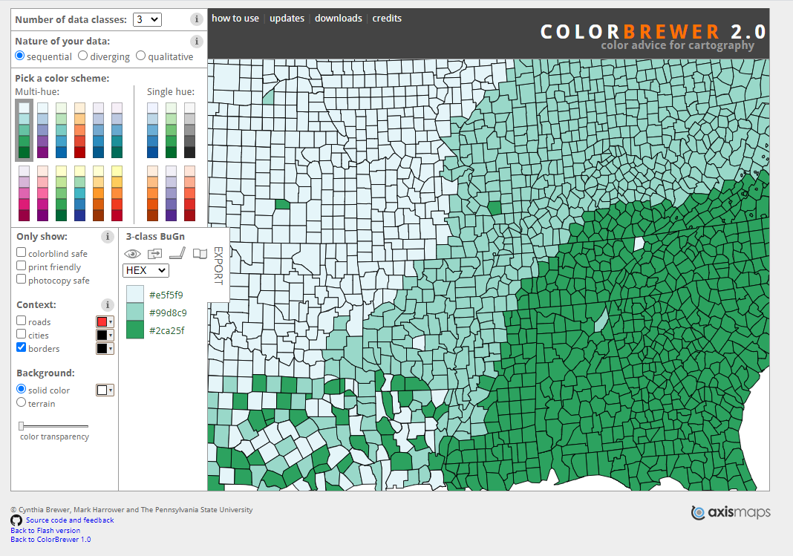
Color recommendations
USGS recommends using light or pastel colors (light colors are easier to read)
Avoid making tiny maps where you can’t distinguish between patterns and colors
Map units that cover small areas might need to have bright labels
colorbrewer2.org

Slide 7
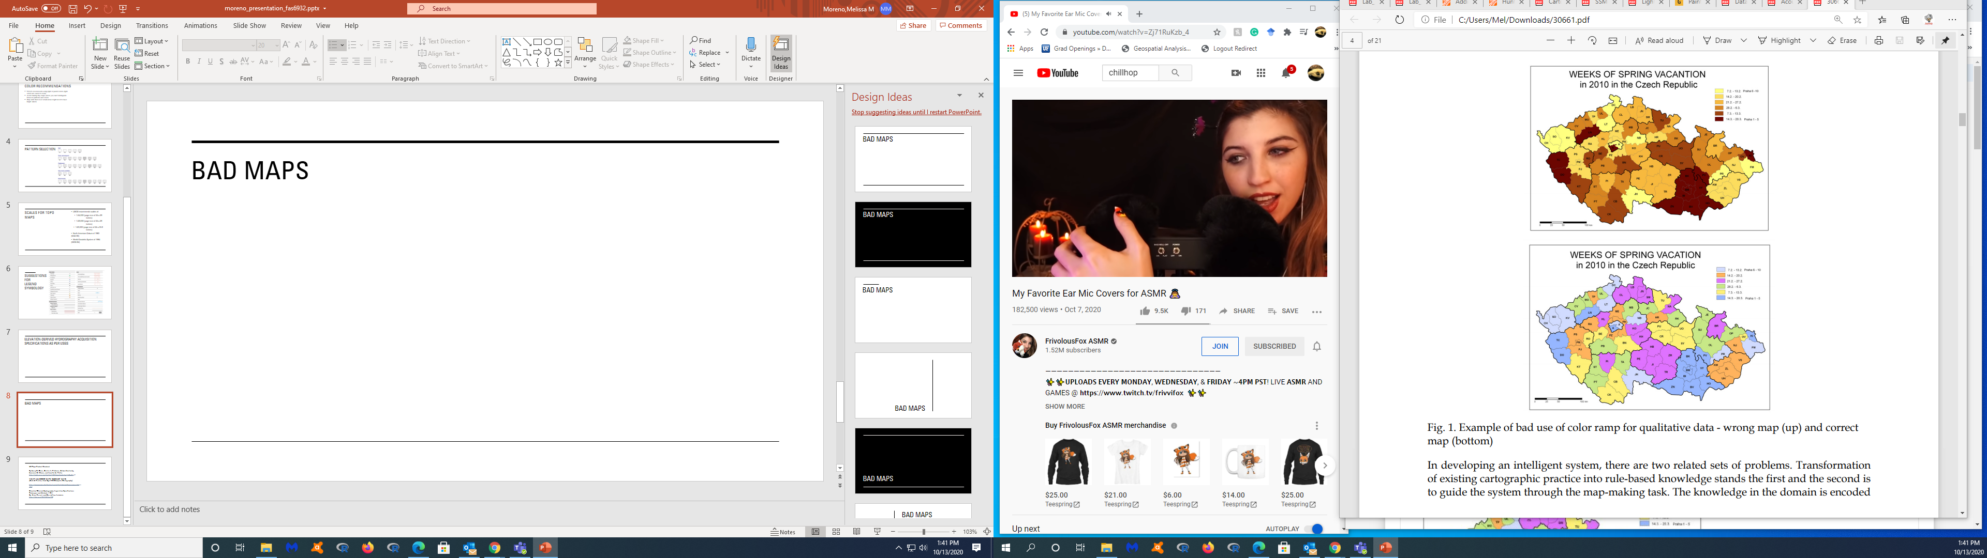
Good or bad colors?
Notes:
Both figures- https://www.researchgate.net/publication/258434003_Validation_Protocol_for_Emergency_Response_Geo-information_Products/figures?lo=1
This graduated color ramp can be used only for quantitative data. Light color (yellow) expresses small value, dark color (brown) expresses big value. The week of vacation is not small or big value.

Slide 8
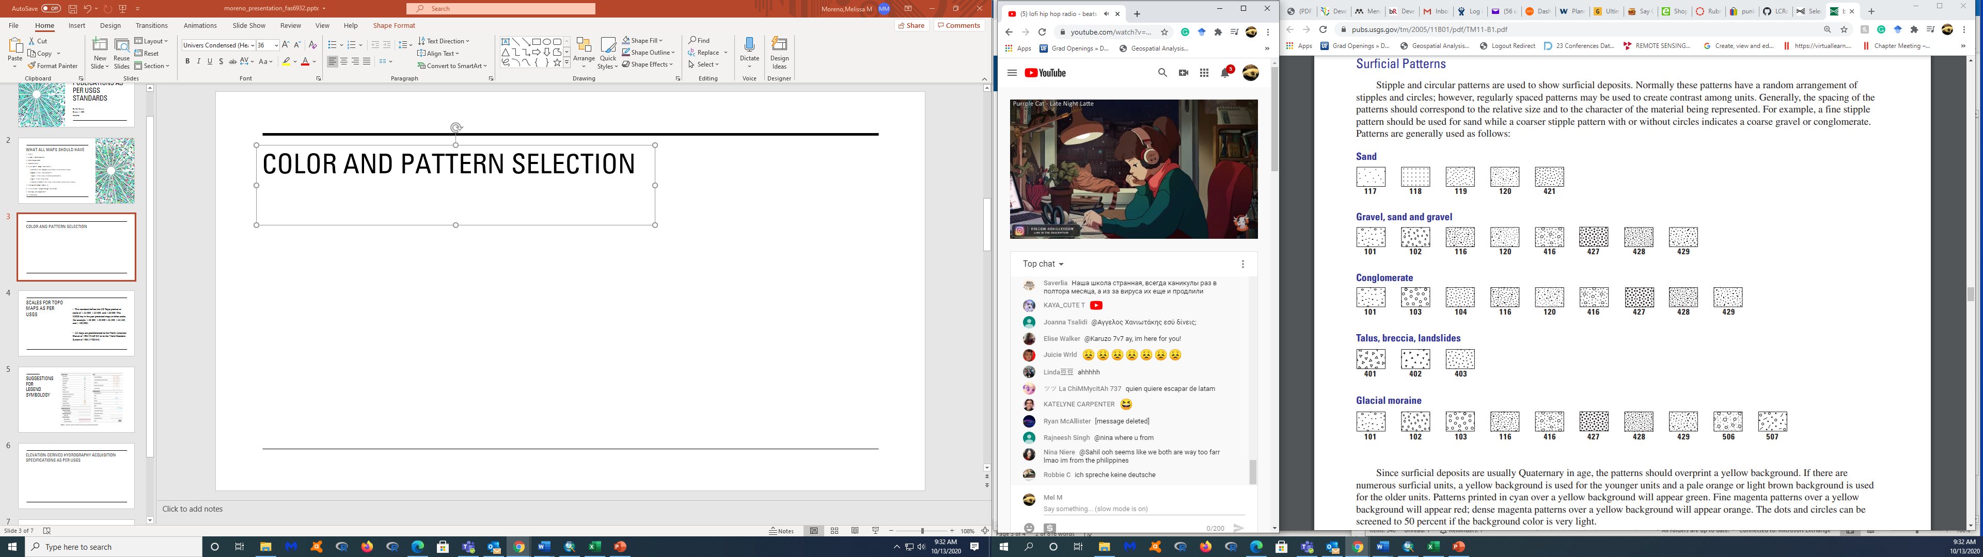
pattern selection

Slide 9
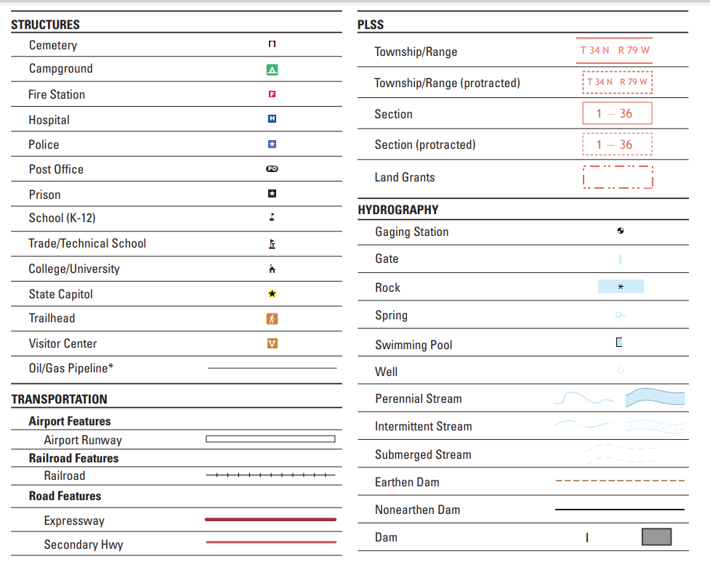
Suggestions for legend symbology

Slide 10
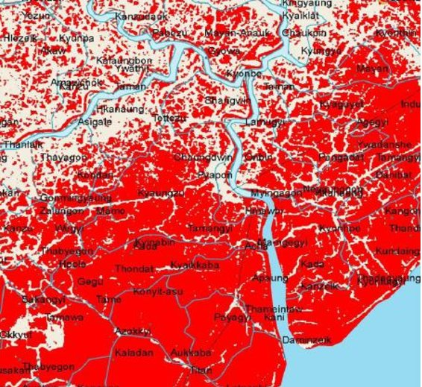
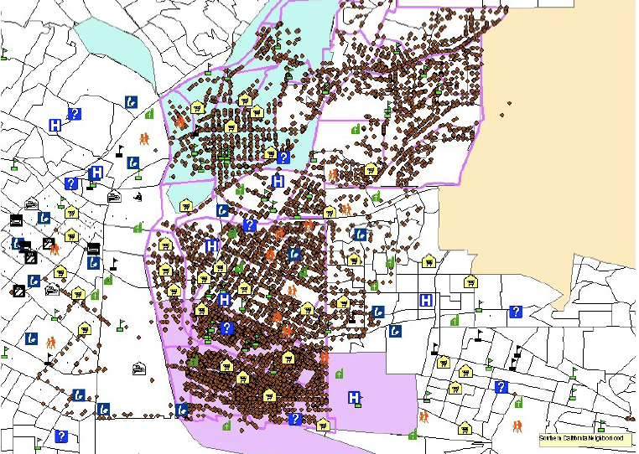
Good or bad Symbology?
Notes:
Both figures (http://katrinalaygo.blogspot.com/2010/01/what-makes-good-and-bad-map.html)
Figure (left) -Example of bad map readability due to inadequate symbols' colours
Figure (right) - There is no title or legend to describe what the map is depicting. A scale bar is missing, as well as a North arrow. The symbols, lines and points in the map do not have a legend for the viewer to understand what they represent. There are also too many red-brown points which make it difficult for the reader to see the map clearly, as many symbols overlap.

Slide 11
Scales for TOPO MAPS
USGS recommends scales of:
1:24,000 (page size of 24 x 29 inches)
1:25,000 (page size of 24 x 29 inches)
1:20,000 (page size of 24 x 33.5 inches)
North American Datum of 1983 (NAD 83)
World Geodetic System of 1984 (WGS 84)

Slide 12
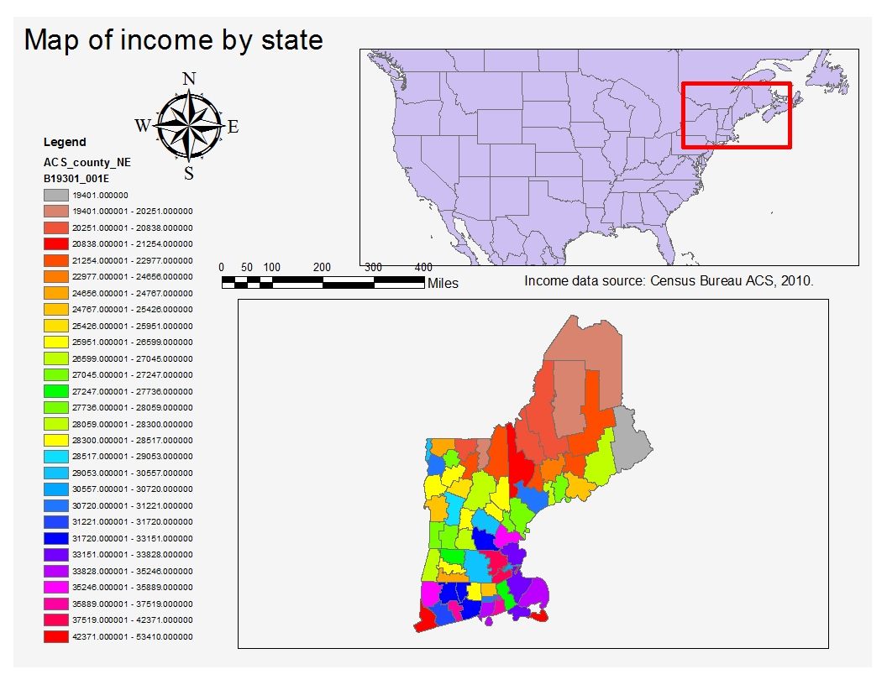
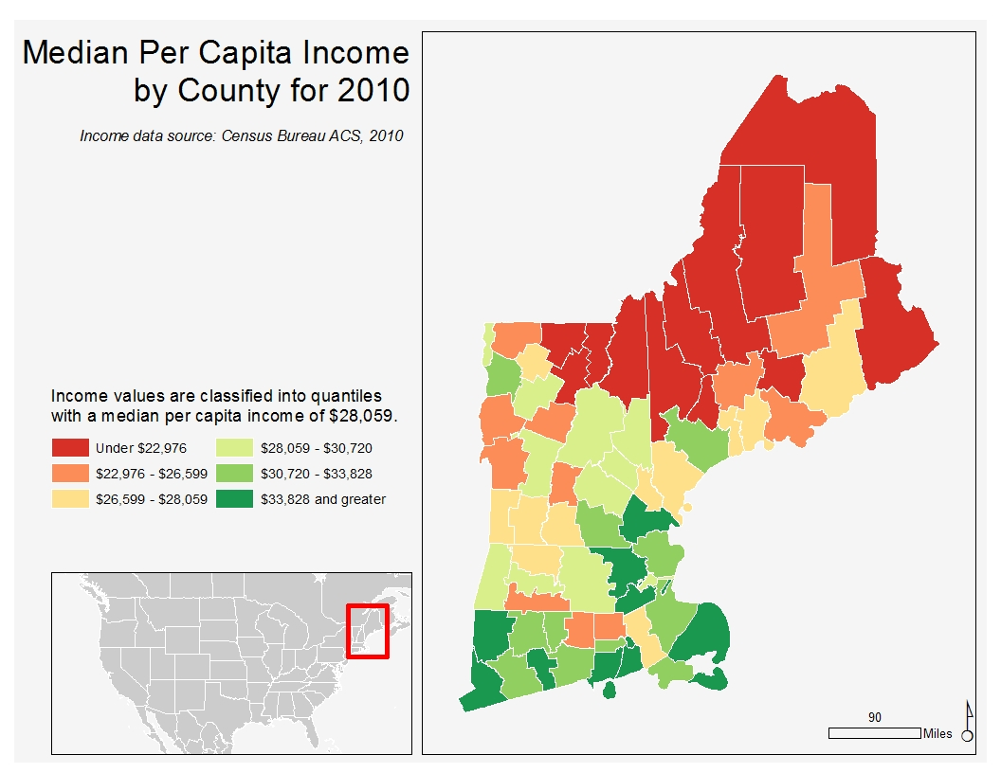
Good or Bad Scale?
Notes:
Figures 1 and 2- https://mgimond.github.io/Spatial/good-map-making-tips.html
What would look better for a publication?
Why is the scale not good on one of the figures?
Why is the color scheme better?

Slide 13
Graphic Requirements
https://www.agu.org/Publish-with-AGU/Publish/Author-Resources/Graphic-Requirements
Preparing and submitting your manuscript – Oxford academic
https://academic.oup.com/journals/pages/authors/preparing_your_manuscript
WHAT ALL GOOD MAPS SHOULD HAVE (Bach & Freelan, from WWU’s ENVS-321 Computer Cartography)
https://www.wwu.edu/huxley/spatial/tut/ALL_GOOD_MAPS.pdf
US Topo Product Standard
By Larry R. Davis, Kristin A. Fishburn, Helmut Lestinsky, Laurence R. Moore, and Jennifer L. Walter
https://pubs.usgs.gov/tm/tm11b2/downloads/tm11b2_v2.pdf
WHAT ALL GOOD MAPS "SHOULD" HAVE
(Bach & Freelan, from Egeo-352 Computer Cartography)
https://www.wwu.edu/huxley/spatial/tut/what_all_maps_must_have.htm
Elevation-Derived Hydrography Acquisition Specifications
Techniques and Methods 11-B11
By: Silvia Terziotti and Christy-Ann Archuleta
https://doi.org/10.3133/tm11B1
Elevation-Derived Hydrography Acquisition Specifications as per USGS
https://pubs.usgs.gov/tm/2005/11B01/pdf/TM11-B1.pdf

